Slide 1
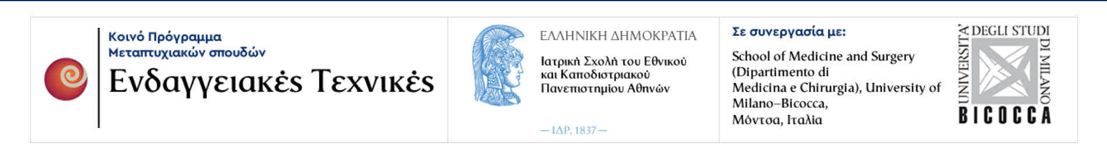
ΠΡΟΓΡΑΜΜΑ ΜΕΤΑΠΤΥΧΙΑΚΩΝ ΣΠΟΥΔΩΝ «ΕΝΔΑΓΓΕΙΑΚΕΣ ΤΕΧΝΙΚΕΣ»
ΔΙΠΛΩΜΑΤΙΚΗ ΕΡΓΑΣΙΑ
LATE POST-EVAR ABDOMINAL AORTIC ANEURYSM RUPTURE.
A REVIEW METANALYSIS STUDY
ΠΑΠΑΔΟΥΛΑΣ ΣΠΥΡΙΔΩΝ
ΑΓΓΕΙΟΧΕΙΡΟΥΡΓΟΣ, ΔΙΕΥΘΥΝΤΗΣ ΕΣΥ
ΠΑΝΕΠΙΣΤΗΜΙΑΚΟ ΝΟΣΟΚΟΜΕΙΟ ΠΑΤΡΩΝ
ΙΟΥΝΙΟΣ, 2023

Slide 2
Post-EVAR Late Aneurysm Rupture
Late rupture is defined as rupture occurring more than 30 days after the EVAR procedure
It is a rare complication (0.9-3.1% of cases within 5 years) with increasing incidence
EVAR may achieve a freedom from AAA rupture in 96% at ten years
Late ruptures after OR have been reported to be <0.8% in 5.5 years
Andersson M, Talvitie M, Benson L, Roy J, Roos H, Hultgren R. A population-based study of post-endovascular aortic repair rupture during 15 years. J Vasc Surg. 2021
Antonopoulos CN, Kakisis JD, Giannakopoulos TG, et al. Rupture after endovascular abdominal aortic aneurysm repair: a multicenter study. Vasc Endovascular Surg. 2014;48: 476–481.

Slide 3
Aim
To investigate and present updated information regarding patients with late aneurysm rupture after EVAR, as the data in the literature is limited
A current literature review and metanalysis was performed based investigating the:
  Incidence
  Causes
  Treatment
  Outcomes
  Prognosis

Slide 4
Methods
A review metanalysis was conducted according to the PRISMA (Preferred Reporting Items for Systematic Reviews and Meta-Analyses) guidelines
Studies were identified by searching electronic databases and scanning bibliographic references from 1991 to April 1st, 2023
Several factors were investigated but the primary endpoints of the meta-analysis consisted of :
  in-hospital mortality
  the comparison of outcomes between open repair and EVAR.

Slide 5
Eligibility, Exclusion and Inclusion Criteria - Late rupture after EVAR
Inclusion Criteria
Case series including at least 6 patients as this disease is relatively rare and this cutoff point was considered numerically significant but also relatively clinically relevant.
Exclusion Criteria
Articles in languages other than English
Elective open conversions or treatment of ruptured AAAs which were considered ineligible due to inadequate relevant information.
Patients with symptomatic aneurysms without rupture were excluded.
Patients with complex EVAR like chimney (chEVAR), fenestrated (fEVAR) or branched (bEVAR) were not included, as our study was focused in the standard infrarenal cases.

Slide 6
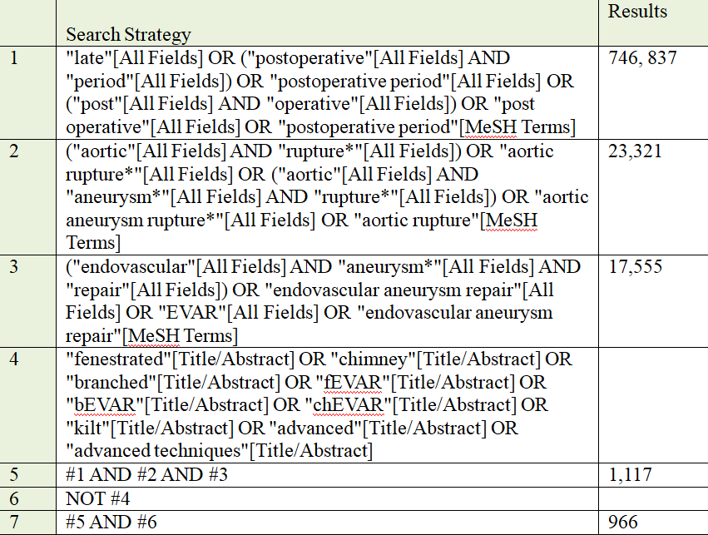
Search Strategy

Slide 7
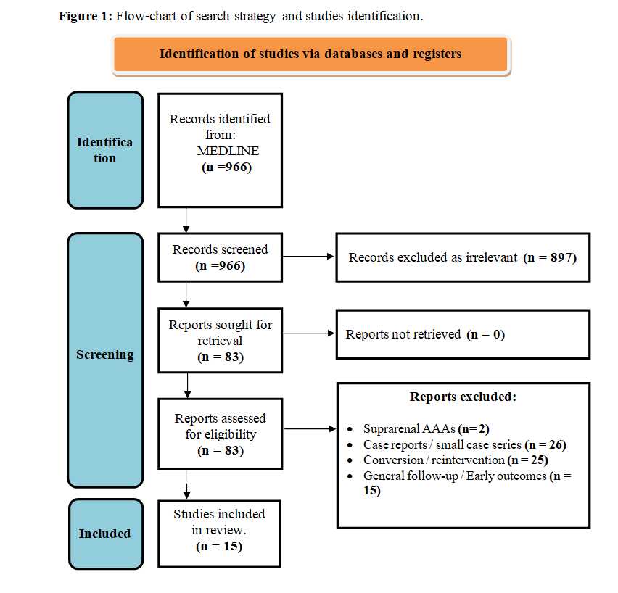
Flow Chart of search strategy

Slide 8
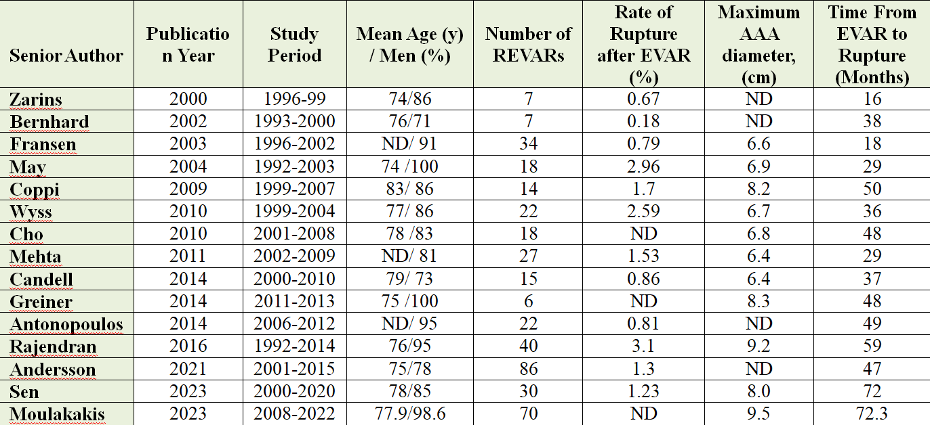
Studies Included
398 patients
Mean age: 76.9
Men: 86.4%
Incidence: 1.11%
Mean AAA: 7.5 cm
Time to rupture: 43.22 m

Slide 9

Types of stent-grafts used in the studies included in our metanalysis

Slide 10
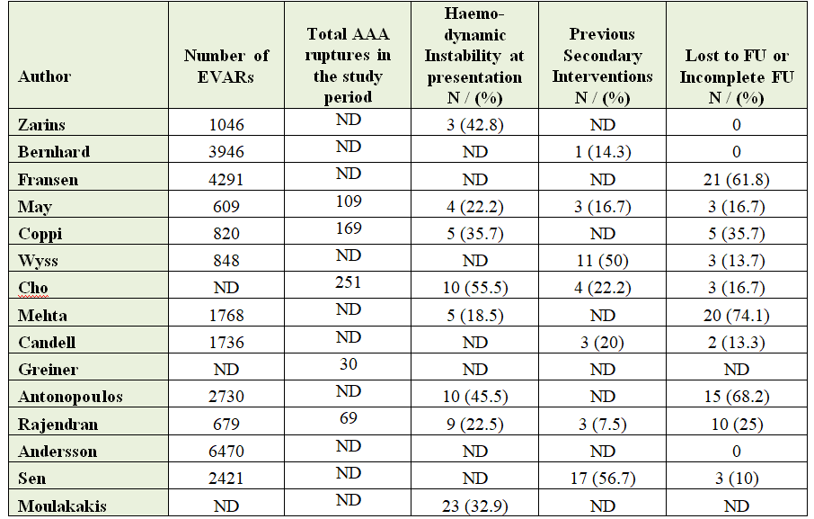
Characteristics - Previous interventions and Compliance to follow up
12.4% :proportion of post-EVAR LARs to total number of ruptured AAA
34.8% : Haemodynamic instability
(56.7%):previous secondary endovascular interventions
(26.4%): follow-up incompliance

Slide 11
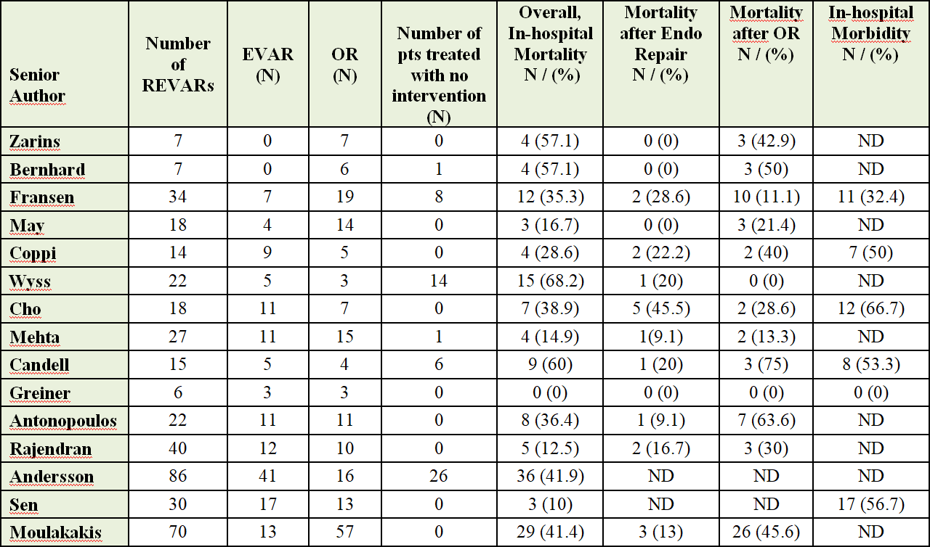
Mortality and Morbidity rate
190 (55.5%) underwent open repair
149(43.6%) endovascular repair
3 (0.9%) hybrid treatment (AUI plus fem-fem)
56 (14.1%) (palliative care)

Slide 12
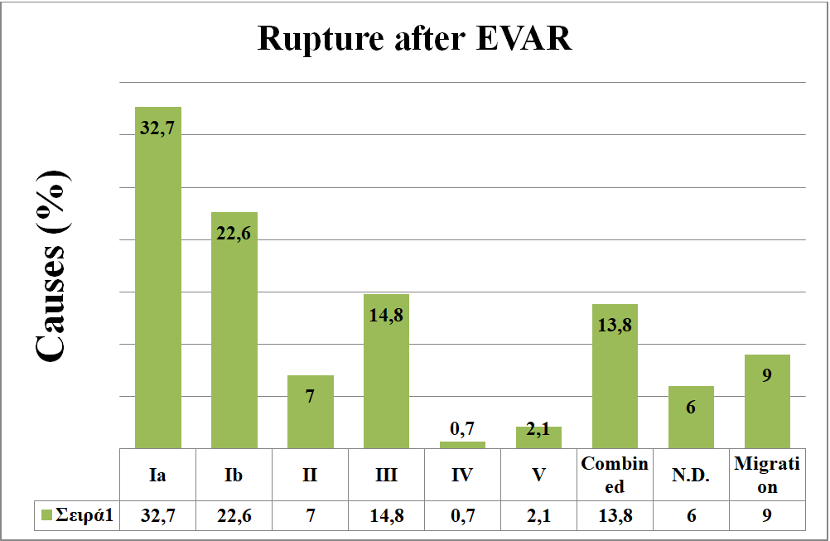
Causes of rupture
55,3%: Type I endoleak
14,8: Type III endoleak
13,8%: Combined endoleaks
9%: Migration

Slide 13
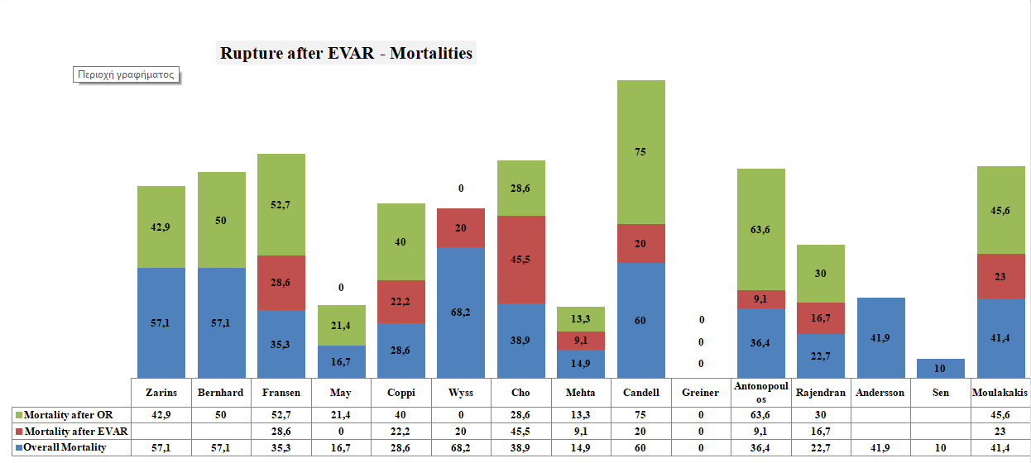
In Hospital Mortality / after EVAR / after OR

Slide 14
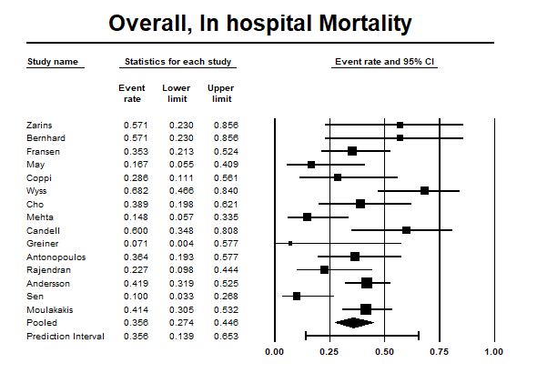
Forest-plot for in-hospital mortality
In-hospital mortality was 35.6% (95% CI, 0.274 to 0.446).
Moderate heterogeneity was identified among the studies
(The Q-value was 34.4 p=0,002, I²=59%).

Slide 15
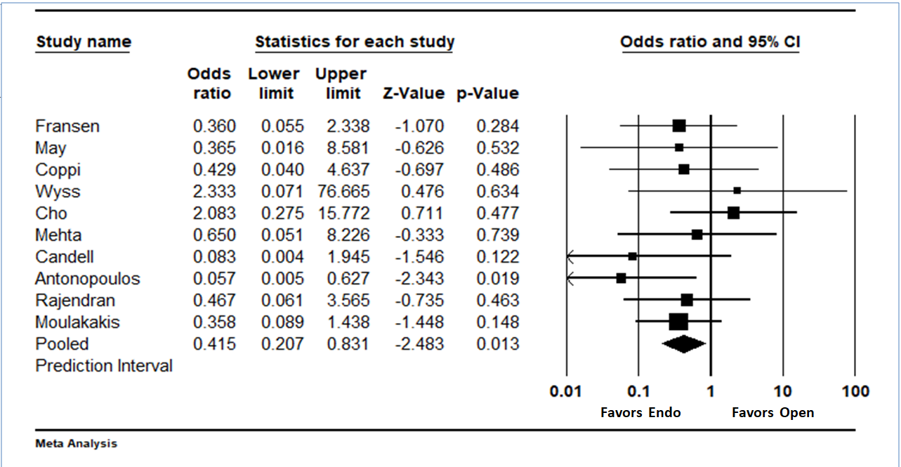
Forest-plot Open vs. Endovascular repair
Open Repair was associated with a significantly higher in-hospital mortality compared to endovascular intervention
pooled odds ratio 0.415
( 95% CI 0.207 to 0.831, Z-value is -2.483 with p = 0.013)
No significant heterogeneity was identified among the studies (The Q-value was 7.21,I²=0%).

Slide 16
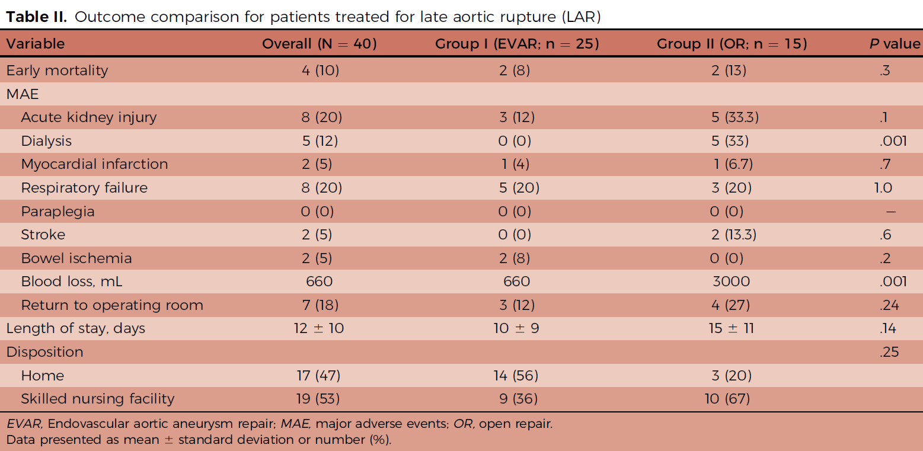
Morbidity
Sen I et al. Clinical presentation, operative management, and long-term outcomes of rupture after previous abdominal aortic aneurysm repair. J Vasc Surg. 2023 Feb;77(2):396-405.e7.

Slide 17
CONCLUSION
Incidence of late rupture after EVAR: 1.11%
12.5% of ruptured AAAs had a stent-graft inside
The most common causes of rupture after EVAR were type Ia and Ib ELs.
Post-rupture mortality after EVAR was high (35.6%) and comparable to the morbidity of de novo ruptures
Endovascular repair appears to have better results compared to conversion to open repair
A significant number of patients had prior endovascular reoperations and inadequate follow-up
Patient compliance with the surveillance protocol is mandatory.

Slide 18

Ευχαριστώ

